Slide 1
Intro to Python Week 7

Slide 2
Overview
Date and Time in Python
Calendar
Create your own functions
Import external python file

Slide 3
Import datetime
A Python program can handle date and time in several ways. Converting between date formats is a common chore for computers. Python's time and calendar modules help track dates and times.
You must import time;
Example:
import time
localtime = time.localtime(time.time())
print ("Local current time :", localtime )
Output:
Local current time : time.struct_time(tm_year=2019, tm_mon=4, tm_mday=5, tm_hour=17, tm_min=28, tm_sec=39, tm_wday=3, tm_yday=95, tm_isdst=0)

Slide 4
Format date
You need to import datetime
Use strftime() method to format the date
%y: to format year
%d: for the date
%m: for the month
import datetime
print(datetime.datetime.today().strftime('%y-%m-%d'))
Output:
19-05-27

Slide 5
Format date and time
You need to import time
Use strftime() method to format the date
%H: for the hour
%M: for the minutes
%S: for the second
%d: for the date
%m: for the month
%y: for the year
import time
print (time.strftime("%d-%m-%y %H:%M:%S") )
Output:
05-05-2019 17:42:27

Slide 6
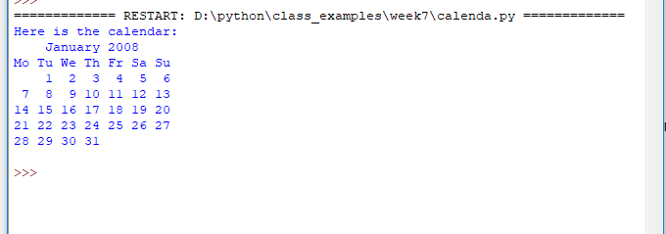
Calendar
You can also import calendar into your program.
import calendar
cal = calendar.month(2008, 1)
print ("Here is the calendar:" )
print (cal)

Slide 7
Create your own functions - 1
A function is a block of organized, reusable code that is used to perform a single, related action.
Functions provide better modularity for your application and a high degree of code reusing. As you already know, Python gives you many built-in functions such as print() and but you can also create your own functions. These functions are called user-defined functions.
How to create a function:
def nameOfFunction() //function without parameter
def nameOfFunction(val) //function with one parameter
def nameOfFunction(val1, val2) //function with 2 parameters

Slide 8
Create your own functions - 2
Example 1: function without parameter
def printname():
print ("Bing Liu")
# Now you can call printinfo function
printname()
printname()
printname()
Note: “Bing Liu” will be printed three times

Slide 9
Create your own functions - 3
Example 2: function with a parameter
def printname(str):
print (“You entered: “ + str)
#!enter a name from your keyboard
name = raw_input("Please enter a name: ")
# Now you can call printinfo function
printname(name)
Note: variable name passed into function as an parameter str.

Slide 10
Create your own functions - 4
Example 3: function with parameters
def printname(str, a):
print ("Name is: " + str)
print("You are " + a + " years old")
#!enter a name and a age from your keyboard
name = raw_input("Please enter a name: ")
age = raw_input("Please enter a age: ")
# Now you can call printinfo function
printname(name, age)
Display true statement

Slide 11
Create your own functions - 5
A function is not necessary to print(display) things inside, but also a function can return values, you can print things outside the functions.
def sum( arg1, arg2 ):
# Add both the parameters and return them."
total = arg1 + arg2
print ("Inside the function : ", total )
return total;
# Now you can call sum function
sumOfTwo = sum( 10, 20 );
print ("Outside the function : ", sumOfTwo)

Slide 12
import modules
A module is a file consisting of Python code. A module can define functions, classes and variables. A module can also include runnable code.
File name: external.py
def print_function(str):
print ("Hello : ", str)
Import module
# Import module external
import external
# Now you can call defined function that module as follows
external.print_function("Bing")
Display message

Slide 13
Reference
www.tutorialspoint.com
http://twitter.com/tutorialspoint
If number >0
Display message

